Slide 1
Unit Testing with NUnit
TCC .Net Team
May 2006

Slide 2
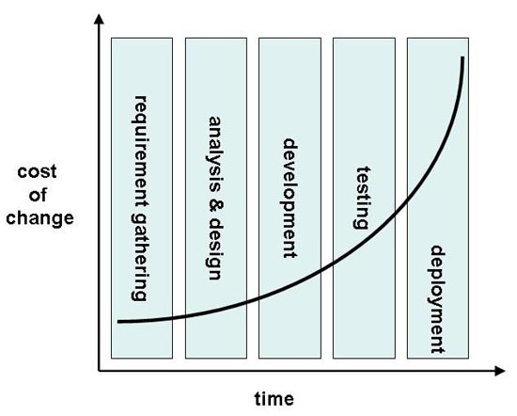

Slide 3
Agenda
Introduction to TDD (Test Driven Development)
Unit Testing
NUnit Framework
Basic outline of a test file
Practices and Demo
Debug in Nunit
Q&A
Quiz

Slide 4
Agenda
Introduction to TDD (Test Driven Development)
Unit Testing
NUnit Framework
Basic outline of a test file
Practices and Demo
Debug in Nunit
Q&A
Quiz

Slide 5
Quotes
“Test-Driven Development is a powerful way to produce well designed code with fewer defects” – Martin Fowler
“The best way that I know to write code is to shape it from the beginning with tests” – Ron Jeffries
“Fewer defects, less debugging, more confidence, better design, and higher productivity in my programming practice” – Kent Beck

Slide 6
Introduction to TDD (Test Driven Development)
TDD is a part of XP
Test code is written before the code to be tested
No implementation code is changed/written without a failing test
Tests are run with every change

Slide 7
TDD’s Main Objective?
TDD’s main objective is not testing software! (this is a side effect)
TDD’s main objective is to aid programmers and customers during the development process with unambiguous requirements.

Slide 8
TDD Flow
Create list of tests
Choose a test and write test
  Run test and fail
Write enough code to compile
  Run test and fail
Write just enough implementation to pass
  Run test and pass
Refactor to remove duplication
Continue with next test…

Slide 9
Flow chart
Start
Write a test for
new capability
Refactor as needed
Compile
Run the test
And see it pass
Fix compile
errors
Write the code
Run the test
And see it fail

Slide 10
Flow Chart
Create the sell or stub class
Create a test case
Run test
Add code
Test OK ?
Test fails
Test Passes

Slide 11
Benefits of TDD
Fewer defects
Less debugging
More confidence
Better design
Higher productivity
Shape code from the beginning with tests!

Slide 12
Why TDD ?
Help find design issues early and avoids rework
Writing code to satisfy a test is a focused activity – less chance of error
Tests will be a more comprehensive than when written after code

Slide 13
Agenda
Introduction to TDD (Test Driven Development)
Unit Testing
NUnit Framework
Basic outline of a test file
Practices and Demo
How to debug in NUnit
Q&A
Quiz

Slide 14
Unit Testing
It is the code wrapper around the app code permitting test tools to execute them for fail-pass conditions
It is non-production code you write to verify that your production code does what you expect
Not requirement testing !
Not acceptance testing !

Slide 15
Unit Testing benefits
Tests will be the first “user” of your system
Reduces time for long testing cycles at the end of projects
Less time debugging
Give more confidence
Reduces code fragility
  Changing a complex system won’t have undetected side effects

Slide 16
What should be tested ?
Boundary conditions (Max/Min value)
Test for out-of-range values
Test for existence ( nulls, non-zero,…)
Correct ordering of results
Correct number of result values
Test for both success and failure

Slide 17
Unit Testing tips
Creating test is not a separate activity from writing an application/component
Run all tests before submitting code to repository
Ideally, run tests with each compilation
Test code is often at least the same size as tested code

Slide 18
Unit Testing – Pros and Cons
Pros
  Regression errors spotted early
  Much more testing will happen
Cons
  Extra work (20%-50%) – can double development time
  Rework of tests if requirement change

Slide 19
Agenda
Introduction to TDD (Test Driven Development)
Unit Testing
NUnit Framework
Basic outline of a test file
Practices and Demo
How to debug in NUnit
Q&A
Quiz

Slide 20
An Intro to NUnit – www.nunit.org
NUnit, a port of JUnit.
Tests can be written in C# or VB.Net (your test language is the same as your development language)
Features 2 interfaces
  GUI : nunit-gui.exe
  Command line : nunit-console.exe ( can also generate XML output)

Slide 21
NUnit Core Concepts
Test Case – a self-validating programmer test that can be automatically discovered and executed independently of other test cases by a test runner.
Test Suite – a collection of test cases or other test suites (described by the Composite pattern)
Test Fixture – a group of test cases sharing a common set of runtime resources (a class)
Notes:
Programmer test – a low level test that aims to verify method level or class level behavior
Self validating test – built in mechanism to validate success or failure without human intervention or interpretation
Automatically discovered – there should be a mechanism in place to unambiguously identify test cases to a test runner
Automatically executed – no numan intervention required to complete execution of a test (no user input required)
Independent of other test cases – no dependency between tests and tests should be able to be run as if they are executed in isolation

Slide 22
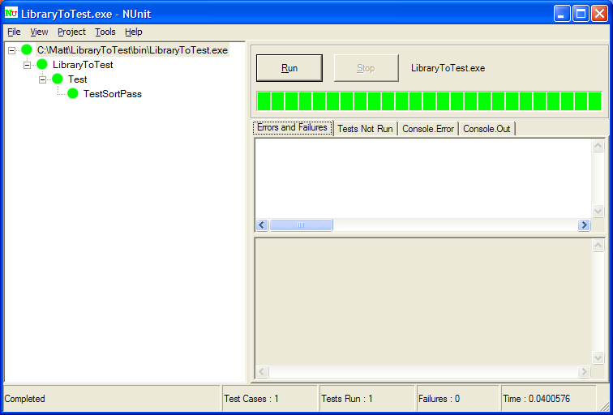
NUnit Screenshot

Slide 23
Assert Class for expression tests
Assert.Fail()
Assert.AreEqual()
Assert.AreSame()
Assert.IsTrue() / Assert.IsFalse()
Assert.IsNull() / Assert.IsEmpty()
Assert.Contains()
Assert.Ignore()
Failure of an assertion fails the current test ( by throwing an AssertionException)
Notes:
Programmer test – a low level test that aims to verify method level or class level behavior
Self validating test – built in mechanism to validate success or failure without human intervention or interpretation
Automatically discovered – there should be a mechanism in place to unambiguously identify test cases to a test runner
Automatically executed – no numan intervention required to complete execution of a test (no user input required)
Independent of other test cases – no dependency between tests and tests should be able to be run as if they are executed in isolation

Slide 24
What is NUnit not ?
It is not Automatic GUI tester
It is not a scripting language, all tests are written in .NET support language ( C#, VC,VB.NET,J#)
It is not a benchmark tool
Passing the entire unit test suite does not mean software is production ready
Notes:
Programmer test – a low level test that aims to verify method level or class level behavior
Self validating test – built in mechanism to validate success or failure without human intervention or interpretation
Automatically discovered – there should be a mechanism in place to unambiguously identify test cases to a test runner
Automatically executed – no numan intervention required to complete execution of a test (no user input required)
Independent of other test cases – no dependency between tests and tests should be able to be run as if they are executed in isolation

Slide 25
Agenda
Introduction to TDD (Test Driven Development)
Unit Testing
NUnit Framework
Basic outline of a test file
Practices and Demo
How to debug in NUnit
Q&A
Quiz

Slide 26
Basic outline of a test file
Using System;
Using Nunit.Framework;
Namespace BasicTest {
  [TestFixture()]
  public class BasicTestApp {
    private int a; // Declare Fields, etc
    [Setup()]
    public void Init() {
      // Put your initialization code here, run at the start of each test case
    }
    [TearDown()]
    public void Clean() {
      // clean code, will be called after each test case
    }
    [Test]
    public void Test(){
      // Test case
    }
Notes:
Programmer test – a low level test that aims to verify method level or class level behavior
Self validating test – built in mechanism to validate success or failure without human intervention or interpretation
Automatically discovered – there should be a mechanism in place to unambiguously identify test cases to a test runner
Automatically executed – no numan intervention required to complete execution of a test (no user input required)
Independent of other test cases – no dependency between tests and tests should be able to be run as if they are executed in isolation

Slide 27
Basic outline of a test file
    [TestFixtureSetup()]
    public void FixtureSetup() {
      // Put your initialization code here, run at the start of all test case
    }
    [TestFixtureTearDown()]
    public void FixtureTearDown() {
      // clean code, will be called after all test case
    }
  }
}
Notes:
Programmer test – a low level test that aims to verify method level or class level behavior
Self validating test – built in mechanism to validate success or failure without human intervention or interpretation
Automatically discovered – there should be a mechanism in place to unambiguously identify test cases to a test runner
Automatically executed – no numan intervention required to complete execution of a test (no user input required)
Independent of other test cases – no dependency between tests and tests should be able to be run as if they are executed in isolation

Slide 28
Setup and TearDown Timeline
Begin Tests
  Call TestFixtureSetup
    Call Setup
      Call TestCase 1
    Call TearDown
    Call Setup
      Call TestCase 2
    Call TearDown
  Call TestFixtureTearDown
End Tests
Notes:
Programmer test – a low level test that aims to verify method level or class level behavior
Self validating test – built in mechanism to validate success or failure without human intervention or interpretation
Automatically discovered – there should be a mechanism in place to unambiguously identify test cases to a test runner
Automatically executed – no numan intervention required to complete execution of a test (no user input required)
Independent of other test cases – no dependency between tests and tests should be able to be run as if they are executed in isolation

Slide 29
TestFixture Attribute
Indicates a class may contain unit tests
Must have a public parameterless constructor (or default contructor)
Must have reference to NUnit.Framework.dll
Notes:
Programmer test – a low level test that aims to verify method level or class level behavior
Self validating test – built in mechanism to validate success or failure without human intervention or interpretation
Automatically discovered – there should be a mechanism in place to unambiguously identify test cases to a test runner
Automatically executed – no numan intervention required to complete execution of a test (no user input required)
Independent of other test cases – no dependency between tests and tests should be able to be run as if they are executed in isolation

Slide 30
Test Attribute
Indicates a class may contain unit tests
Must have a public parameterless constructor (or default contructor)
Must have reference to NUnit.Framework.dll
Notes:
Programmer test – a low level test that aims to verify method level or class level behavior
Self validating test – built in mechanism to validate success or failure without human intervention or interpretation
Automatically discovered – there should be a mechanism in place to unambiguously identify test cases to a test runner
Automatically executed – no numan intervention required to complete execution of a test (no user input required)
Independent of other test cases – no dependency between tests and tests should be able to be run as if they are executed in isolation

Slide 31
ExpectedException Attribute
Indicates normal testing will throw the specified exception
Test pass only if that exception is thrown
[Test]
[ExpectedException(typeof(InvalidOperationException)) ]
public void TestOne(){
  //Code that throw InvalidOperationException
}
Notes:
Programmer test – a low level test that aims to verify method level or class level behavior
Self validating test – built in mechanism to validate success or failure without human intervention or interpretation
Automatically discovered – there should be a mechanism in place to unambiguously identify test cases to a test runner
Automatically executed – no numan intervention required to complete execution of a test (no user input required)
Independent of other test cases – no dependency between tests and tests should be able to be run as if they are executed in isolation

Slide 32
Agenda
Introduction to TDD (Test Driven Development)
Unit Testing
NUnit Framework
Basic outline of a test file
Practices and Demo
How to debug in NUnit
Q&A
Quiz

Slide 33
Practices and Demo
Simple Test cases
Bank Example
More complicated Unit tests
Notes:
Programmer test – a low level test that aims to verify method level or class level behavior
Self validating test – built in mechanism to validate success or failure without human intervention or interpretation
Automatically discovered – there should be a mechanism in place to unambiguously identify test cases to a test runner
Automatically executed – no numan intervention required to complete execution of a test (no user input required)
Independent of other test cases – no dependency between tests and tests should be able to be run as if they are executed in isolation

Slide 34
Simple TestCases
[Test]
public void Test_Add()
{
int result = calculator.Add(2, 2);
Assertion.AssertEquals(4, result);
}
[Test]
[ExpectedException(typeof(DivideByZeroException))]
public void Test_DivideByZero()
{
int result = calculator.Divide(1, 0);
}

Slide 35
Simple TestCases
[Test] [ExpectedException(typeof(DivideByZeroException))]
public void TestMathLib_DivideByZeroException()
{
double result = Math.MathLib.Divide(value2, 0);
//Assert.Fail("Divide by Zero Exception");
}
[Test]
[Ignore("Decide how to implement this function")]
public void TestMathLib_SQRT()
{
//do some thing
}

Slide 36
Agenda
Introduction to TDD (Test Driven Development)
Unit Testing
NUnit Framework
Basic outline of a test file
Practices and Demo
How to debug in NUnit
Q&A
Quiz

Slide 37
How to debug in NUnit
We have 2 ways
Debug by attaching our program to process Nunit-gui.exe ( we have to run Nunit-gui.exe first) → not convenient
Modify commandline parameter in VS.NET ( Debug by program Nunit-gui.exe)
    → widely used
  To debug many assemblies at the same time, specify them in file *.nunit ( only way)
Notes:
Programmer test – a low level test that aims to verify method level or class level behavior
Self validating test – built in mechanism to validate success or failure without human intervention or interpretation
Automatically discovered – there should be a mechanism in place to unambiguously identify test cases to a test runner
Automatically executed – no numan intervention required to complete execution of a test (no user input required)
Independent of other test cases – no dependency between tests and tests should be able to be run as if they are executed in isolation

Slide 38
Template *.nunit file
<NunitProject>
  <Config>
  <assembly path = “Bin\Debug\Bank.dll”
  <assembly path = “Bin\Debug\Stack.dll”
  ....
  </Config>
<NunitProject>
Notes:
Programmer test – a low level test that aims to verify method level or class level behavior
Self validating test – built in mechanism to validate success or failure without human intervention or interpretation
Automatically discovered – there should be a mechanism in place to unambiguously identify test cases to a test runner
Automatically executed – no numan intervention required to complete execution of a test (no user input required)
Independent of other test cases – no dependency between tests and tests should be able to be run as if they are executed in isolation

Slide 39
How to debug in NUnit
Set the testing project as the startup project in the solution
Open the test project properties
In the Configuration Properties->Debugging , set the "start action" to "start external program" and select the Nunit-gui.exe or the Nunit-console.exe
Set the Command Line Arguments to the relative path to the NUnit project file

Slide 40
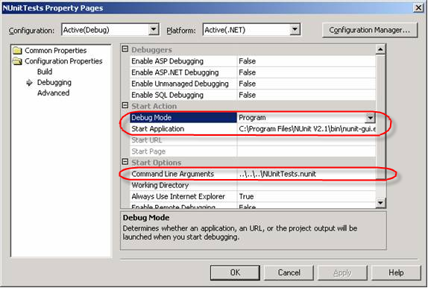

Slide 41
How to debug in NUnit
Set the break point in your code
Hit F5 to run project, NUnit Gui will be loaded
Choose the testcase you want to debug and run it

Slide 42
How to debug in NUnitTest
Another way to debug in NUnitTest, highly recommend (easier) :
  install Ncover
  install NCoverExplorer
  install NUnit
  install TestDriven.NET
Create a console project test and go on

Slide 43
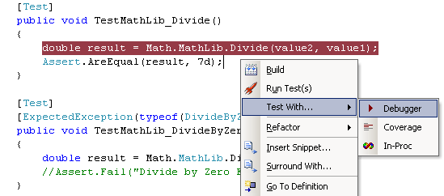
How to debug in NUnitTest

Slide 44
Questions and Answers (Q&A)
Notes:
Programmer test – a low level test that aims to verify method level or class level behavior
Self validating test – built in mechanism to validate success or failure without human intervention or interpretation
Automatically discovered – there should be a mechanism in place to unambiguously identify test cases to a test runner
Automatically executed – no numan intervention required to complete execution of a test (no user input required)
Independent of other test cases – no dependency between tests and tests should be able to be run as if they are executed in isolation

Slide 45


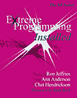
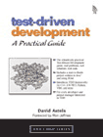
Recommended Resources (1/2)
Test Driven Development
Kent Beck
ISBN 0321146530
Test Driven Development
Dave Astels
ISBN 0131016490
Extreme Programming Explained
Kent Beck
ISBN 0201616416
Extreme Programming Installed
Ron Jeffries, Ann Anderson
and Chet Hendrickson
ISBN 0201708426

Slide 46
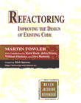
Recommended Resources (2/2)
Refactoring – Improving the design of existing code
Martin Fowler, et al.
ISBN 0201485672
TDD Mailing List
http://groups.yahoo.com/group/testdrivendevelopment
Unit testing database code
http://www.dallaway.com/acad/dbunit.html
NUnitASP
http://nunitasp.sourceforge.net
NUnit
http://www.nunit.org
(Check the mailing lists)

Slide 47
Quiz and Exercise
Notes:
Programmer test – a low level test that aims to verify method level or class level behavior
Self validating test – built in mechanism to validate success or failure without human intervention or interpretation
Automatically discovered – there should be a mechanism in place to unambiguously identify test cases to a test runner
Automatically executed – no numan intervention required to complete execution of a test (no user input required)
Independent of other test cases – no dependency between tests and tests should be able to be run as if they are executed in isolation

Slide 48
Thanks for your attention
Notes:
Programmer test – a low level test that aims to verify method level or class level behavior
Self validating test – built in mechanism to validate success or failure without human intervention or interpretation
Automatically discovered – there should be a mechanism in place to unambiguously identify test cases to a test runner
Automatically executed – no numan intervention required to complete execution of a test (no user input required)
Independent of other test cases – no dependency between tests and tests should be able to be run as if they are executed in isolation

